Slide 1
Capstone Project 5
Face Emotion Recognition
Deployment
Team Members
Sumeet Agrawal
Rajashekar Korutla

Slide 2
Create Flask File
Create HTML File
Create flask file for webcam
Deployment in Local Host
Live testing with webcam
Deployment in Heroku
Contents

Slide 3
Steps to create flask file
Open the VS Code
Create a new Virtual Environment
Import ‘Emotion_little_vgg.h5’ file and .xml file.
Create app.py file and write flask codes.
Also create a html file and linked with app.py
After running app.py we got an host link
https://127.0.0.1:5000/
Create Flask File

Slide 4
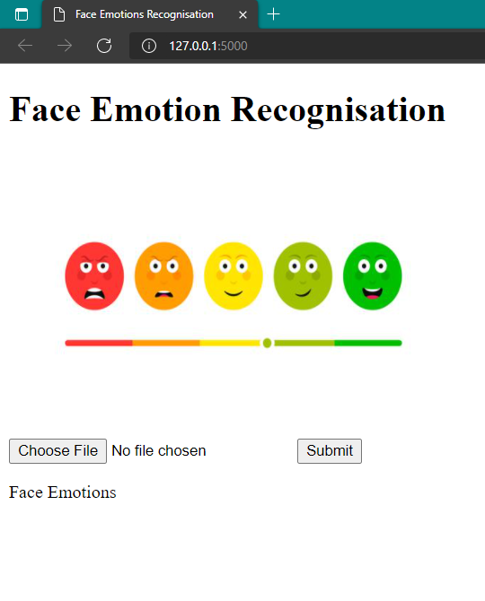
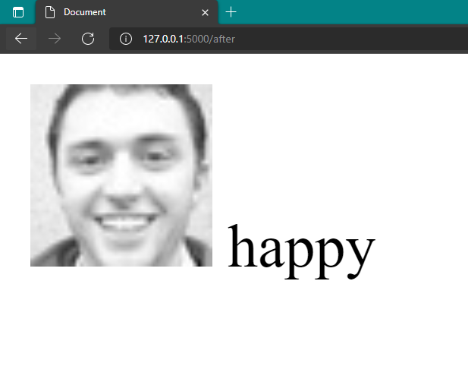
Local host

Slide 5
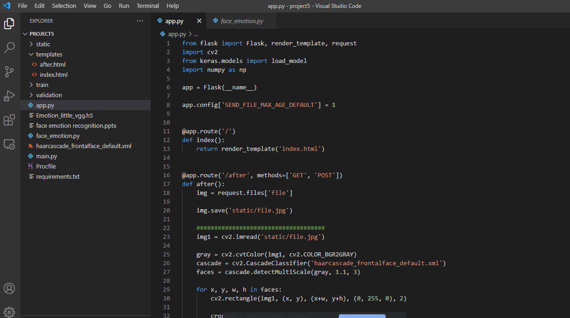
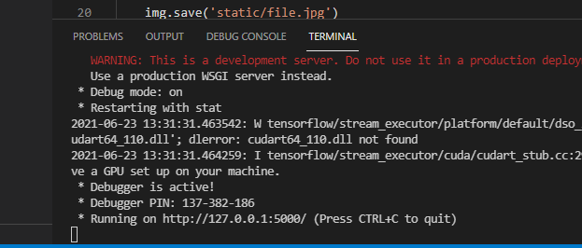
Create Flask File

Slide 6
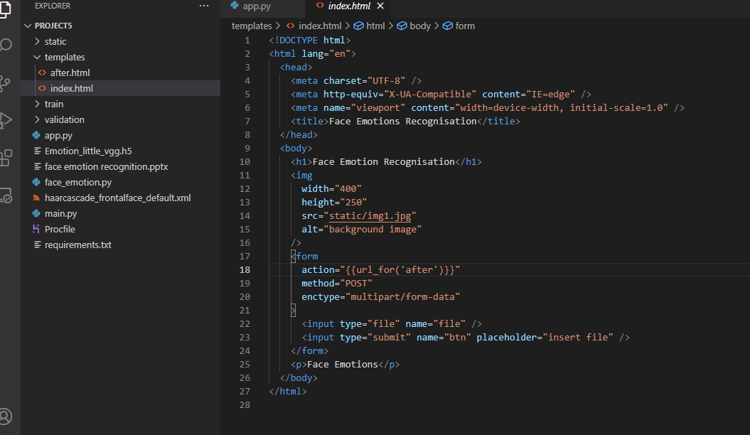
Add Html link to app.py

Slide 7
Create another Flask file for Webcam
In this face_emotion.py file we wrote codes of opencv.
Through opencv we will be able to access the webcam.
We will be able to make live predictions of face emotions.

Slide 8
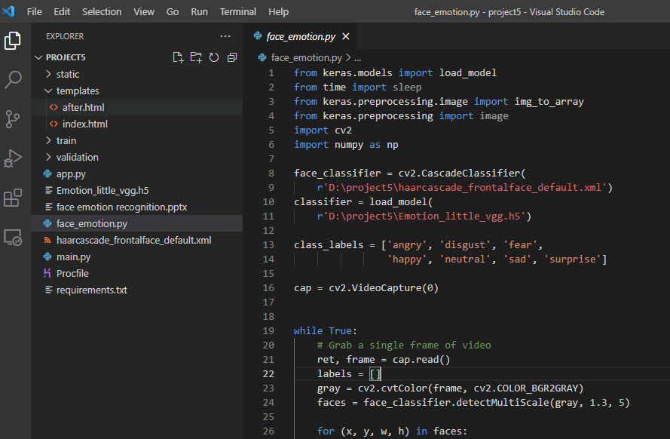
Create another Flask file for Webcam

Slide 9
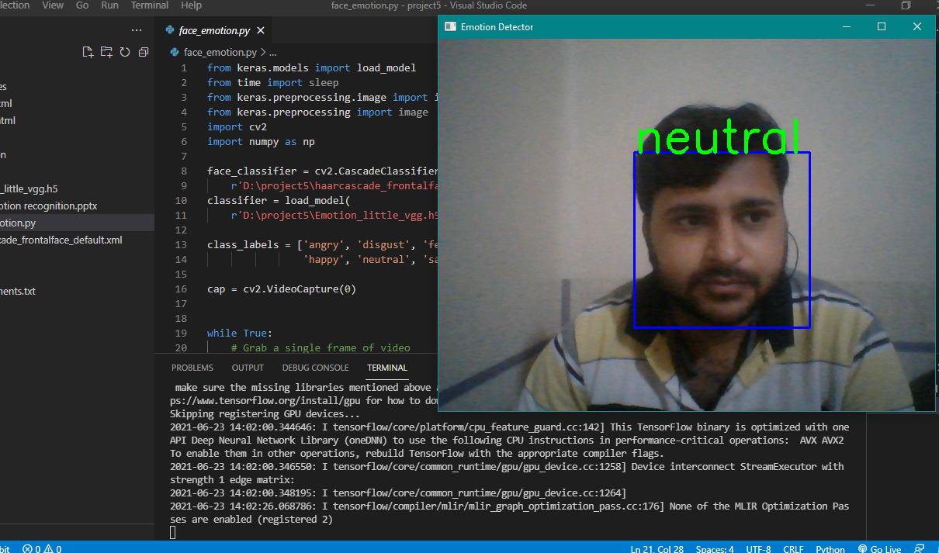
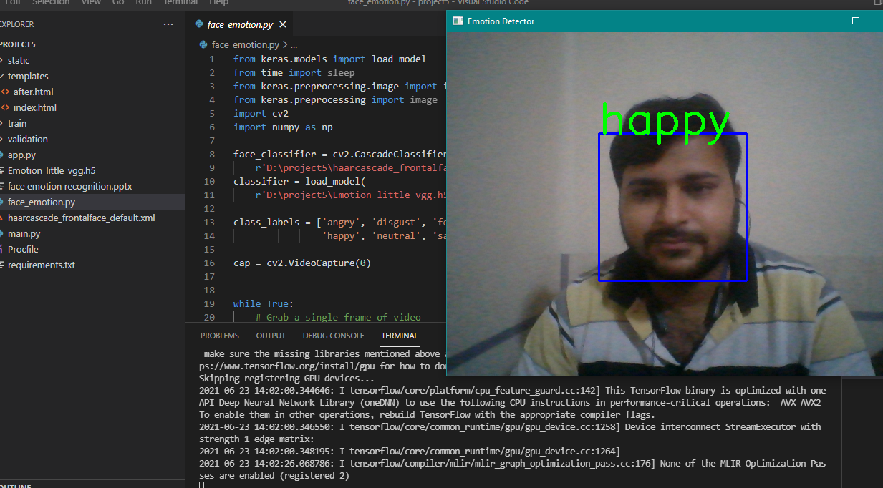



Slide 10
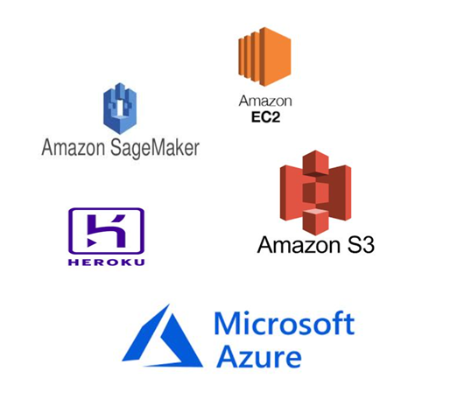
Deployment
Amazon(AWS) EC2
AWS Sage-maker(AWS) s3 Bucket
Heroku
Microsoft Azure

Slide 11
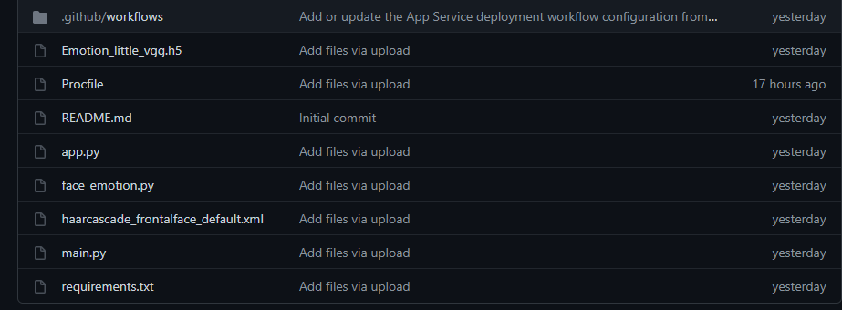
Github

Slide 12
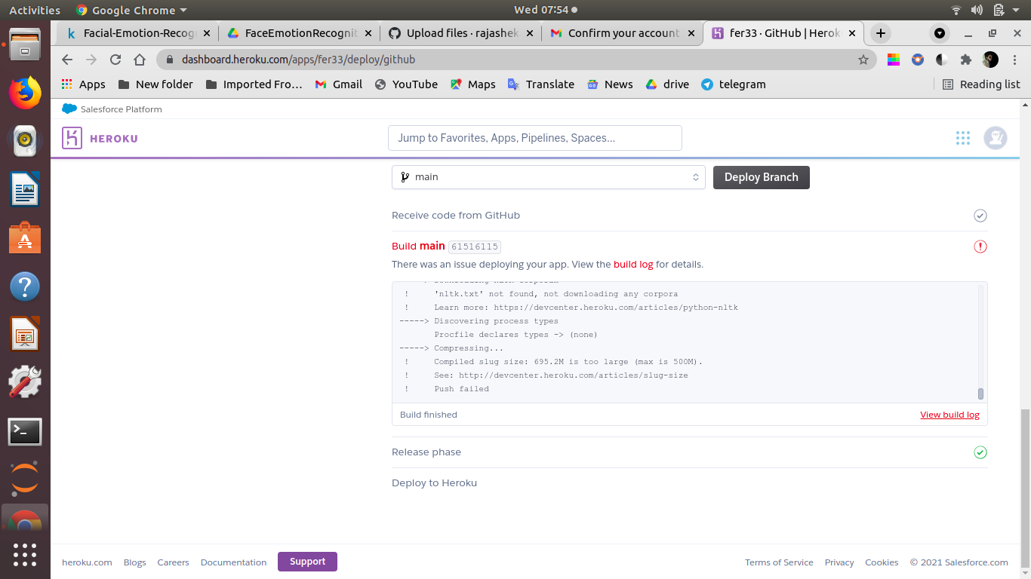
Deployment in Heroku

Slide 13
Deployment Issues We faced
In Heroku we faced the issue of size limit.
In Microsoft Azure we don’t have account. For creating account its simply asking for credit card details which we don’t have.
Similar issues with AWS services.

Slide 14
THANK YOU

